Slide 1
Degenerative & Osteoporotic Spine Diseases: Surgical Management
Justin Millard, MD

Slide 2
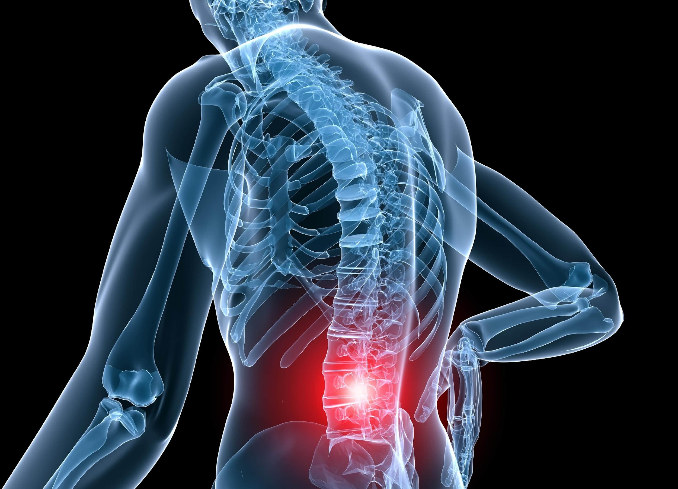
Epidemiology
Low back pain is one of the leading causes of disability worldwide
Affects 619 million people globally (WHO 2020)
61.7 million physician visits for low back pain in the US in 2008¹
Prevalence increases with age; greatest among people aged 80-85 years old
Annual rates in the general population in 2018²
39 million individuals with spondylolisthesis
403 million individuals with symptomatic disc degeneration
103 million individuals with spinal stenosis

Slide 3
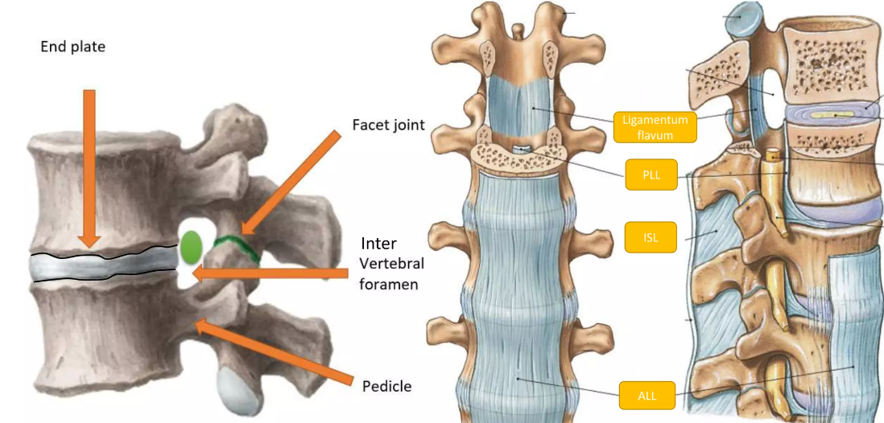
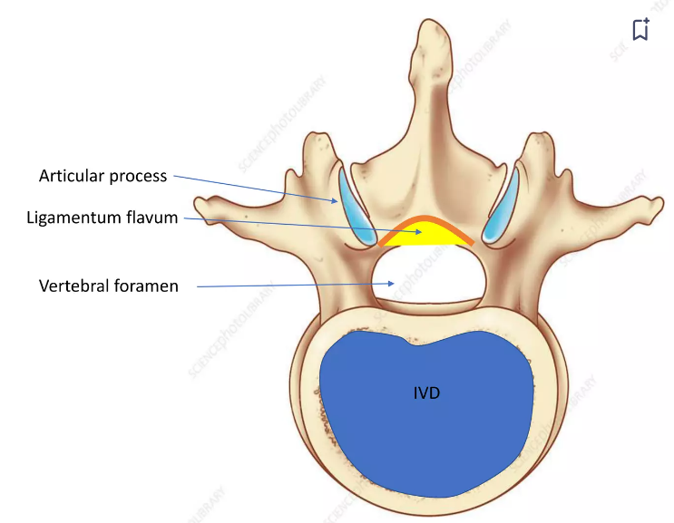
Lumbar Spine Anatomy
Degeneration can occur at the intervertebral disc, vertebral end plates, vertebral body, facet joints, or ligamentum flavum

Slide 4
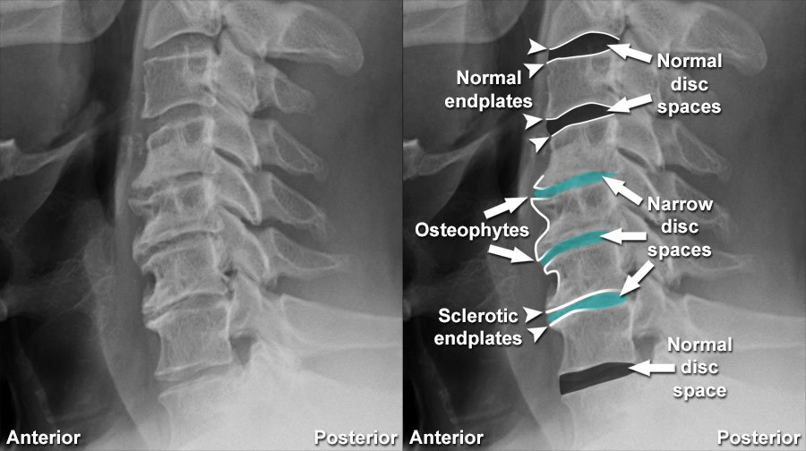
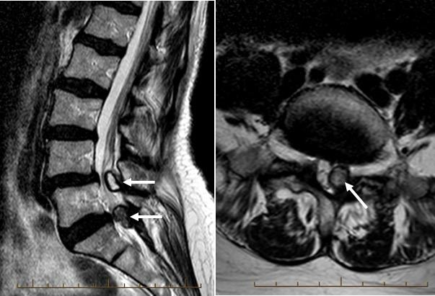
Pathoanatomy
Degenerative changes include:
Cartilage loses water content and wears away
Narrowing of the joint
Osteophyte formation
Synovial cyst formation

Slide 5
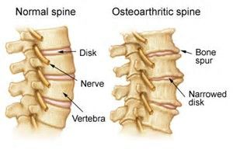
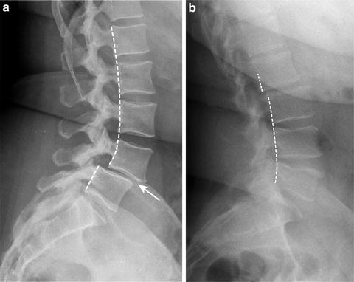
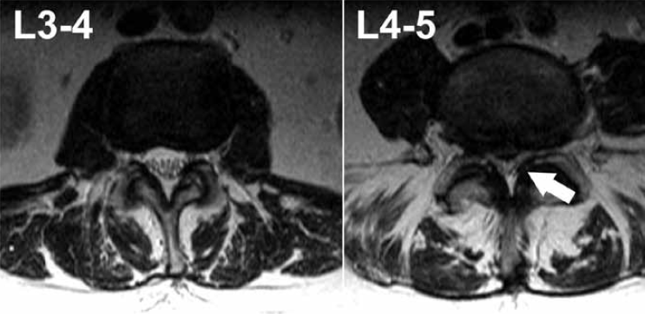
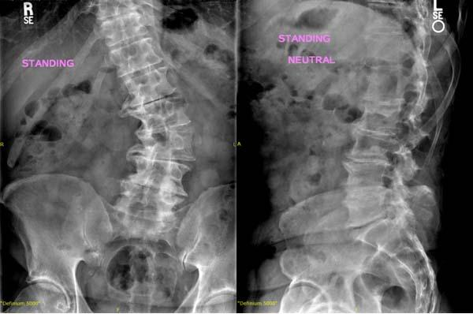
Degenerative Spine Conditions
Spondylosis: degeneration of the vertebrae and disc
Spinal stenosis: narrowing of the spinal canal due to bony or soft tissue structures
Spondylolisthesis: forward slippage of a vertebrae
Scoliosis: asymmetric degeneration of the disc space or facet joints resulting in spinal curvature

Slide 6
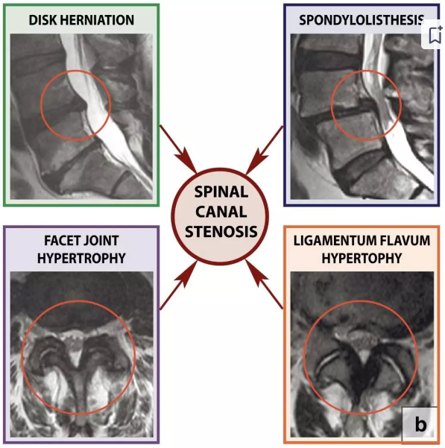

Slide 7
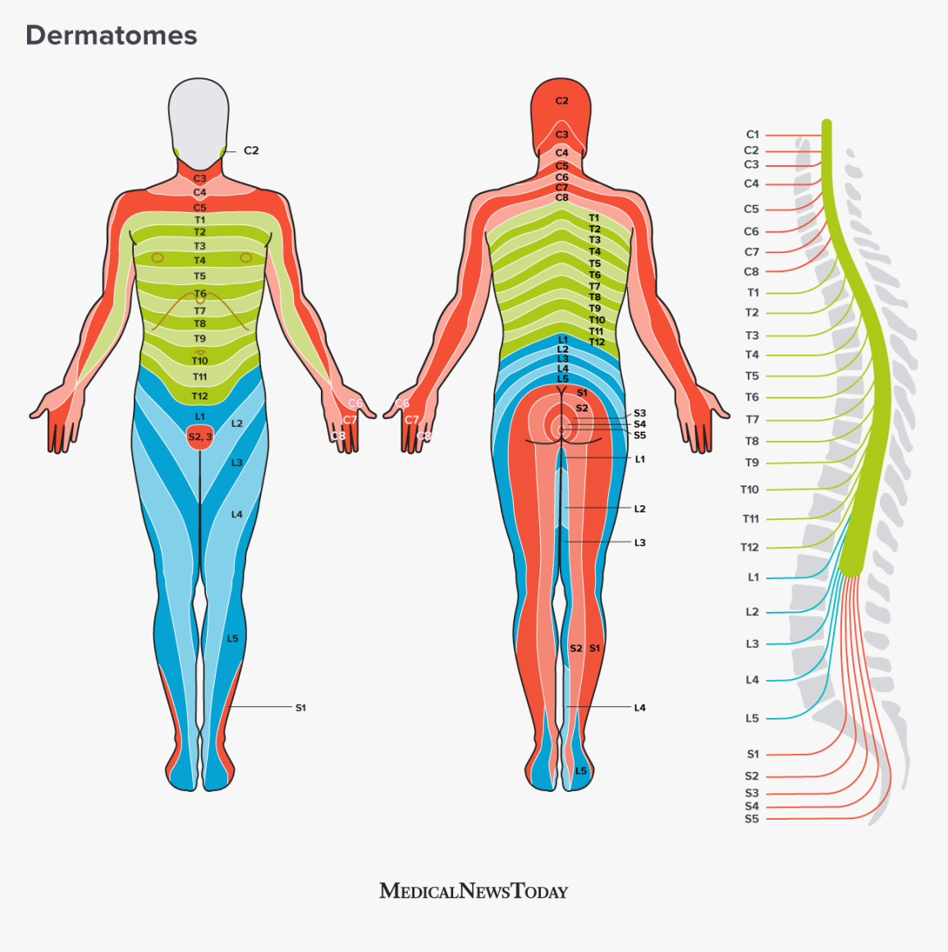
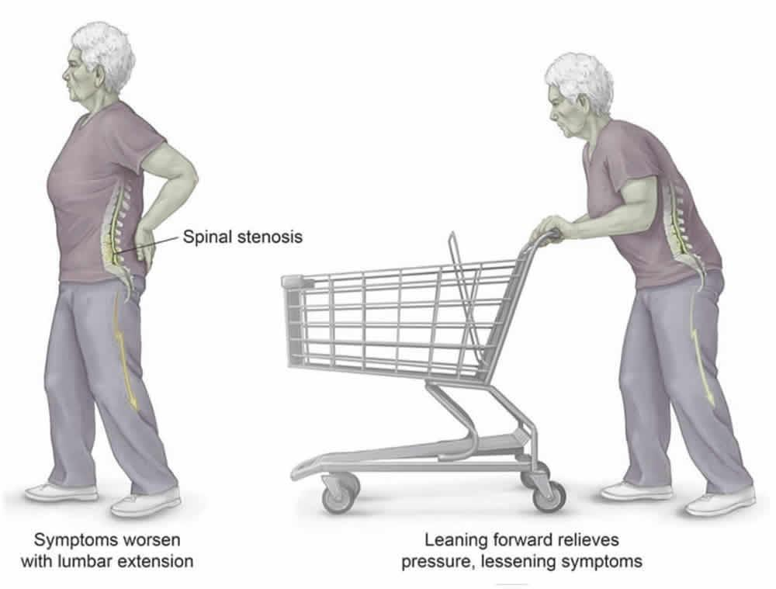
Signs & Symptoms
Axial low back pain
Unilateral leg pain, numbness, or tingling
Weakness
Neurogenic claudication
Buttock and leg pain caused by upright walking
Pain relieved by sitting or leaning forward
Decreased walking tolerance

Slide 8
Non-Operative Treatment
Anti-inflammatory medications
Muscle relaxants
Activity modifications
Physical therapy
Chiropractic adjustment or manipulation
Acupuncture
Bracing
Epidural steroid injections
Biologics: stem cells vs. platelet rich plasma (PRP)

Slide 9
Prognosis
90% of low back pain resolves within one year
Factors associated with good outcomes with non-operative treatment
Lack of radiculopathy
Factors associated with worse outcomes with non-operative treatment
Obese patients (BMI >30)
Symptoms present for more than 6 months
If there is persistent and debilitating pain, then may consider surgical management

Slide 10
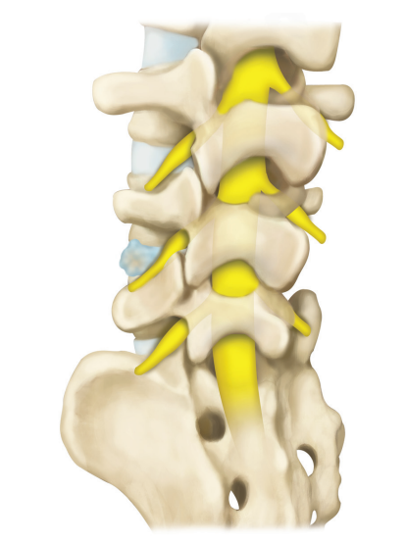
Operative Treatment
Interbody Fusion
Goal: Address discogenic pain and restore intervertebral height indirectly decompressing nerves
Different approaches exist:
posterior approach involves laminectomy, partial or complete facetectomy, discectomy
transforaminal approach is a modification of posterior where the disc is exposed through the foramen with a facetectomy.
anterior approach is performed through the side of the body to expose the front of the vertebrae
foramen
spinous process
disc
lamina
facet

Slide 11
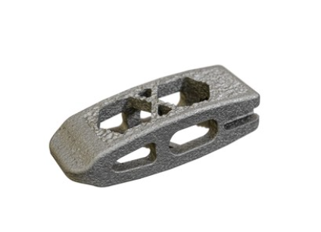
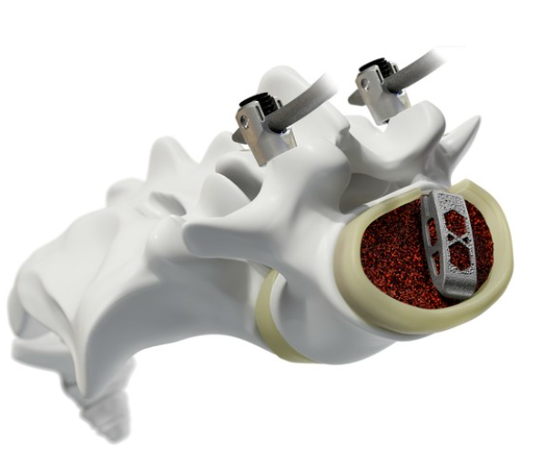
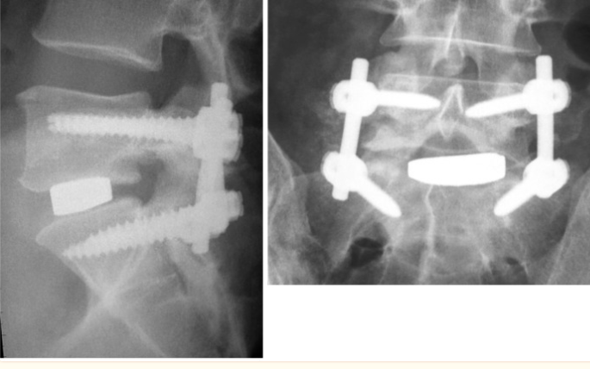
Interbody Fusion
Achieved by preparing the endplate of the vertebrae and insertion of interbody device. May supplement with posterior screw instrumentation.

Slide 12
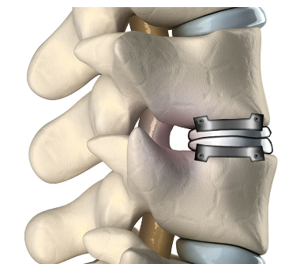
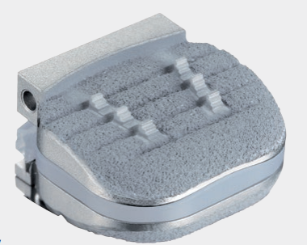
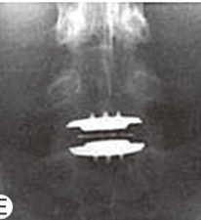
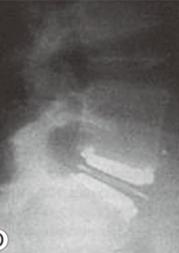
Operative Treatment
Disc Replacement
Goal: insert artificial disc between the vertebrae to replace a natural spinal disc. This will eliminate discogenic pain, restore vertebral height and maintain motion.
Performed for young, active individuals with good bone quality and normal facet joints

Slide 13
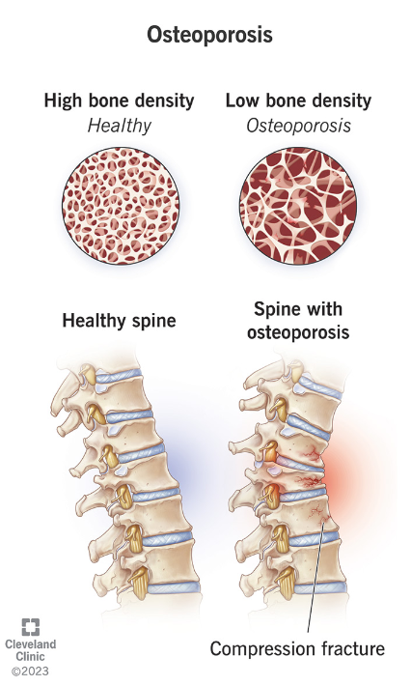
Osteoporosis & The Spine
Osteoporosis = weakening of the bones
Fragile bones become susceptible to fractures
Spinal compression fractures are the most common ones seen in patients suffering from osteoporosis
25% of postmenopausal women experience spinal compression fractures, which increases to 40% when aged 80+
Patients who experience a compression fracture have five times higher chance of experiencing recurrent fractures

Slide 14
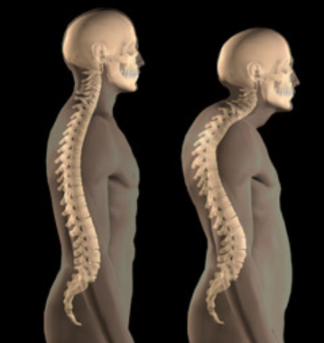
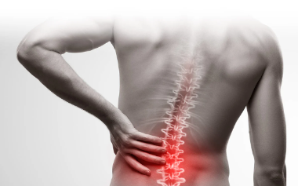
Compression Fractures
Osteoporosis-related fractures in the spine may lead to:
Persistent back pain, which worsens with movement or activities.
Limited mobility,
which may make it challenging to perform daily activities such as walking, bathing, and dressing.
Change in posture,
such as exaggerated rounding of the upper back

Slide 15
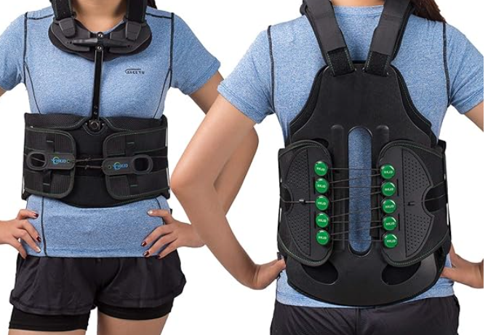
Non-operative Treatment
Rest
Pain medications
Back brace
Physical therapy

Slide 16
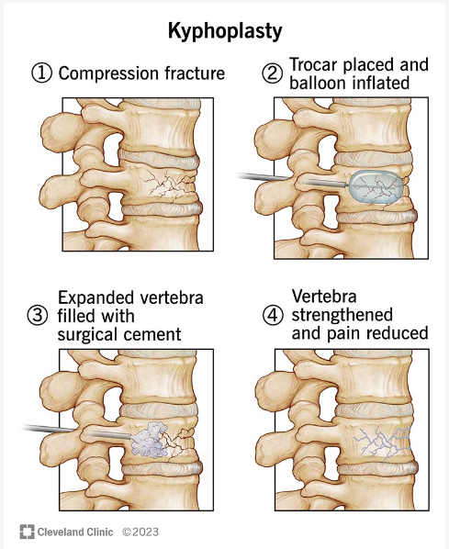
Operative Treatment
Kyphoplasty
Fractured vertebrae filled with cement to strengthen the vertebra and reduce pain
Minimally invasive, short duration, and outpatient
Symptoms should improve by 48 hours after the procedure
You may be a candidate if you have worsening back pain after a trial of nonoperative treatment

Slide 17
References
Licciardone JC. The epidemiology and medical management of low back pain during ambulatory medical care visits in the United States. Osteopath Med Prim Care. 2008 Nov 24;2:11. doi: 10.1186/1750-4732-2-11. PMID: 19025636; PMCID: PMC2631527.
Ravindra VM, Senglaub SS, Rattani A, et al. Degenerative Lumbar Spine Disease: Estimating Global Incidence and Worldwide Volume. Global Spine Journal. 2018;8(8):784-794. doi:10.1177/2192568218770769
Donnally III CJ, Hanna A, Varacallo M. Lumbar Degenerative Disk Disease. [Updated 2023 Aug 4]. In: StatPearls [Internet]. Treasure Island (FL): StatPearls Publishing; 2024 Jan-. Available from: https://www.ncbi.nlm.nih.gov/books/NBK448134/
Raja A, Hoang S, Patel P, et al. Spinal Stenosis. [Updated 2023 Jun 12]. In: StatPearls [Internet]. Treasure Island (FL): StatPearls Publishing; 2024 Jan-. Available from: https://www.ncbi.nlm.nih.gov/books/NBK441989/
Traeger A, Buchbinder R, Harris I, Maher C. Diagnosis and management of low-back pain in primary care. CMAJ. 2017 Nov 13;189(45):E1386-E1395. doi: 10.1503/cmaj.170527. PMID: 29133540; PMCID: PMC5687927.
Lee YC, Zotti MG, Osti OL. Operative Management of Lumbar Degenerative Disc Disease. Asian Spine J. 2016 Aug;10(4):801-19. doi: 10.4184/asj.2016.10.4.801. Epub 2016 Aug 16. PMID: 27559465; PMCID: PMC4995268. https://www.ncbi.nlm.nih.gov/pmc/articles/PMC4995268/
National Spine Health Foundation. Updated January 16, 2024. https://spinehealth.org/article/osteoporosis/
Cleveland Clinic. Kyphoplasty. Accessed 7/22/2024. https://my.clevelandclinic.org/health/procedures/kyphoplasty

